Slide 1
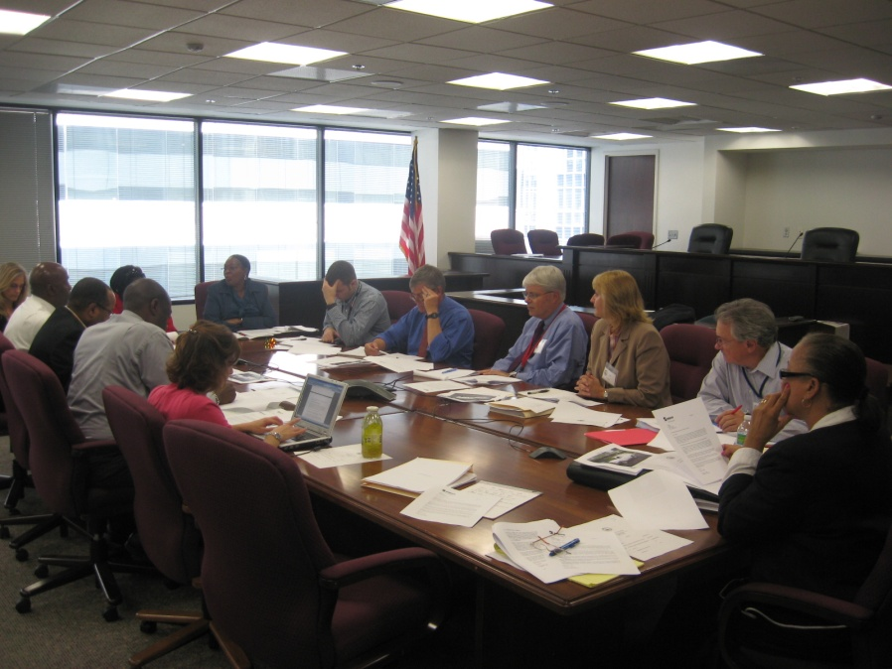
Bringing the Public to the Table: Citizen Involvement with the D.C. Public Service Commission
Marie C. Johns
Marie Johns
Founder/President, L&L Consulting, LLC

Slide 2
Importance of Public Input
Public input provides citizens, nongovernmental organizations and businesses the opportunity to contribute to and comment on proposed rules.
Public input can promote democratic legitimacy by strengthening the connections between government agencies and the public they serve.
The ultimate goal of having public input is to help improve the quality of agency rulemaking.

Slide 3
Contribution of Public Input to Energy Conservation Policy
“In developing our pro-conservation philosophy, the Commission has relied upon leading community activists from the D.C. Consumers Utility Board, ANCs, American Association of Retired Persons, Gray Panthers, Americans for Democratic Action, and numerous other civic and community organizations. As an agency concerned about the community, the Commission will continue to incorporate the ideas of the citizens of the District of Columbia. Community voices for conservation have been strong, untied, and on-key. With the help of the community, PEPCO, WG, the Office of the People’s Counsel (“OPC”) and Commission Staff, I am confident that 1992 will be a significant year for energy conservation achievement.”
Source: Quote from Commissioner Edward M. Meyers in the Commission’s 1991 Annual Report., page 7.

Slide 4
Benefits of Public Input
“I think these sessions are very, very important both for myself and for the Commission to get a feeling for the community's attitude and desires concerning the current rate increase which PEPCO has asked for.” - Formal Case No. 685 (4/22/1978)
“It is because The Office of the People’s Counsel has taught us how to participate in the regulatory process that we are represented here today.” - Formal Case No. 912 (5/4/1992)
“It is up to the Commission to ensure that Verizon fully informs consumers clearly so that real negotiations can occur without people being deceived, confused or whatever the reason is. Please help all of us.” - The Office of the People's Counsel Town Hall Meeting (1/9/2013)

Slide 5
Office of the People’s Counsel
The Office of the People's Counsel (OPC) is an independent agency of the District of Columbia government. By law, it is the advocate for consumers of natural gas, electric and telephone services in the District. The Office also represents the interests of District ratepayers before regulatory agencies.
OPC was re- established by the Home Rule Act effective in 1975. Annice Wagner was the first People's Counsel after Home Rule, appointed by the elected Mayor Walter Washington.
OPC is authorized to investigate the operation and valuation of utility companies independently of any pending proceeding.
OPC's mandate is to advocate the provision of quality utility service and equitable treatment at rates that are just, reasonable, and nondiscriminatory to assist individual consumers in disputes with utility companies about billing or services; and to provide technical assistance and consumer education to the Consumer Utility Board (CUB) and other community groups.

Slide 6
Consumer Utility Board - CUB
Founded in 1977; Non-partisan and community based.
Independent group of D.C. citizens who are not affiliated with any utility company.
Advances and protects the interests of District of Columbia utility ratepayers and consumers.
CUB weighs in on selection of People’s Counsels and PSC Commissioners.
CUB was brain child of Brian Lederer, former People’s Counsel.
OPC staffer Rick Powell was instrumental in creation of CUB.
OPC has usually had 1 employee dedicated to working with CUB.

Slide 7
Founding Members of CUB
Labor
Labor, Retail Clerks, Local 400 - Charles Warfield
National Treasury Employees Union, Chapter 209 - Edward DeVaughn
ANCs & Civic Associations
Chevy Chase Citizens Association and ANC 3G - George Haley
Lamond-Riggs Civic Association - Carrie James
ANC 7B - Robert Thompkins
ANC 2D - Mair Moody
ANC 2C - Joyce Chestnut
ANC 5C - Edra Derricks
Community Organizations
United People - Barbara Pugh-Baker
Gray Panthers - Joseph Davis
All Electric Users, AC/DC Committee - Robert Grahn
Southeast Neighbors - Pat Abrams
Friendship House - Ronald Cooper
League of Women Voters & Americans for Democratic Action - Mary Drob
Housing Counseling Services - Marjorie Shuman
Churches
Church of God in Christ - M. O. Metcalf
Israel Baptist Church - Charles Weaver
Conference of Baptist Ministers - Reverend Walter Gray
Government
D.C. Council - Phinis Jones for Councilmember Rolark
Private Sector
AOBA - Frann Francis
DC Chamber of Commerce - Arthur Henderson
Central Labor Council - Benjamin Shellman
UDC - Jerome Paige

Slide 8
PSC Office of Consumer Services
Vivian Jordan Webb, first Director of Consumer Services Office (OCS) & OCS Staff
OCS was established in 1981 to mediate consumer complaints after the PSC approved a Consumer Bill of Rights (CBOR).

Slide 9
PSC - Informal Consumer Complaint Mediation

Slide 10
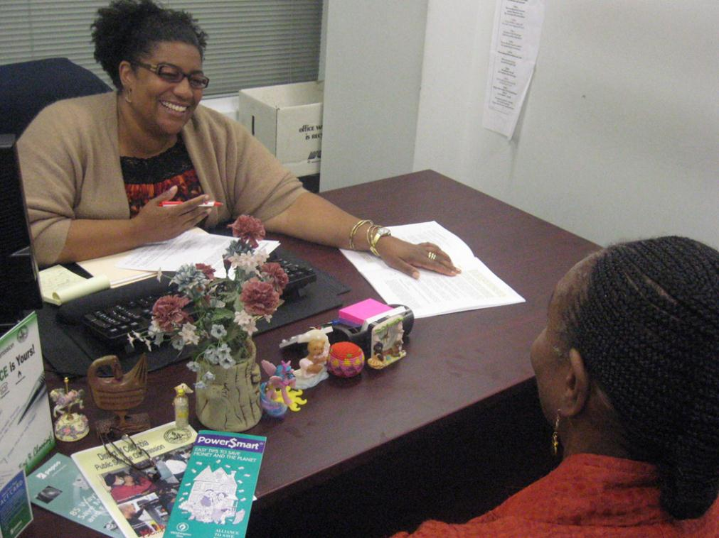
OCS staff person explains PSC programs to help save energy and money. OCS’s role includes educating consumers of their rights and responsibilities and the availability of programs to help them manage the affordability of their utility bills.

Slide 11
Public Input Milestones
1913 | PUC mails notices of hearings to Federation of Citizen Associations (FCA) & other civic groups
1920s | 1926 - People's Counsel established - met with citizen and industry groups; ex officio member of FCA
1950s | 1951 – People’s Counsel position eliminated
1960s & 70s | PSC addresses socio-economic issues in formal cases that engages a diverse range of community organizations
1970s | 1970 - PSC meeting with community - after hours re Pepco's minority hiring in a rate case
 | 1975 - Home Rule and formation of DC Council & OPC; Council passes ANC Great Weight legislation
 | PSC starts holding community hearings routinely in rate cases and other proceedings
 | 1977 - CUB formed; 1979 - CUB report on electricity conservation issued
1980s | CUB weighs in on selection of PCs and Commissioners
 | PSC establishes Office of Consumer Services
 | PSC establishes working groups (WGs)– (e.g. Productivity Improvement WG & Load Research Advisory WG) involving stakeholders to address technical issues outside of evidentiary proceedings
 | PSC establishes low-income discount and energy conservation programs and requires companies to post newspaper & radio ads and parties to collaborate on educational campaigns to increase participation
1990s | 1991 - Educational campaigns - Take it to the Streets & People Serving the Community
 | 1991 - PSC creates community based payphone program
 | 1993 - First PSC video and postings on DC Cable TV
 | 1994 - PSC first creates working group with citizen members - TRS Advisory Group
2000s | PSC implements technology that broadens it outreach - website, eDocket, streaming, mobile app
 | PSC sets goal of 100 outreach events each year; distributes bags with PSC logo
 | 2010 - PSC creates AMI Task Force that includes citizen groups to create and implement smart meter educational campaigns
 | 2011 - PSC complies with open mtg. law; 2nd PSC video
 | 2012 – PSC requires Pepco to implement an EnergyWise Rewards educational program. Program cycles air conditioners during peak usage.

Slide 12
Evolution of Organizations Participating in PUC/PSC Proceedings
1913 – to date | Federation of Citizen Associations (White)
1940s to date | Federation of Civic Associations (Black)
1970s – Pre Home Rule (HR) | Urban League; United Planning Organization; DC City Wide Consumer Council; Capitol Group Ministry; Students Hot on Conserving Kilowatts (SHOCK – Sierra Club); Center City Community Corporation; CHANGE, Inc.; Senior Citizens Committee, DC Federation of Civic Associations, Electric Utility Employees Union, Apartment House Council of the Metropolitan Washington Builders Association
1970s – After HR | People’s Counsel; All Electric Customers; All Souls Church; AOBA; Center for United Labor Action; Consumers Urging Rate Equity; D.C. Power; League of Women Voters; Lincoln-Westmoreland Housing, Inc.; Washington Public Interest Organization; Friendship House; Black United Front; AARP; AC/DC, ANCs.; DC Coalition of Concerned Citizens; Sursum Corda Housing; shareholders; and company representatives. Some intervened and some testified in newly established community hearings.
1980s | Consumer Utility Board (CUB); Coalition of Concerned Citizens; Civic Associations; Office of Aging; ANCs; Citizen Associations; DC Council members; Solar Coalition; River Terrace Community
1990s | All Electric Customers; Minority Business Enterprise Legal Defense Fund; CUB; ANCs; Civic Associations; Sierra Club; AARP; Citizen Associations; Council of Churches; River Terrace Community
2000s | ANCs; Civic Associations; CUB; AARP; MD/DC/VA Solar Energy Industries; Hands Together Neighborhood Club; Carter Barron Community Task Force; Politics & Prose; Climate Action Committee; Gray Panthers; First Baptist Church; H Street, Main Street; Michael Sindram; Citizen Associations

Slide 13
Community Hearings

Slide 14
Potomac Electric Power Company’s (PEPCO's) Benning Road Generating Station

Slide 15
Benning Road Facility
Built in 1906
Six documented releases of toxic polychlorinated biphenyls (PCBs) between 1985 and 2003
PCB contamination of the Anacostia River

Slide 16
PEPCO’s Request
On June 9, 1988, PEPCO filed Application with PSC.
PEPCO sought permission and approval to construct two combustion turbine units at Benning Road Generating Station.
PSC opened Formal Case No. 877 on July 13, 1988.

Slide 17
Public Opposition
District of Columbia River Terrace Community Organization (River Terrace)
Advisory Neighborhood Commission (ANC) 7-D and ANC 5-B
Telesis Corporation
Washington Metropolitan Area Transit Authority (WMATA)

Slide 18
Petition of River Terrace Community Organization
251 letters from private citizens
Petitions containing 452 signatures
Raised issues of environmental concern

Slide 19
The Advisory Neighborhood Commissions
Advisory Neighborhood Commissions (ANCs) consider a wide range of policies and programs affecting their neighborhoods.
ANCs are the body of government with the closest official ties to the people in a neighborhood.
ANCs present their positions and recommendations on issues to various District government agencies, the Executive Branch, and the Council.
ANC 5B Committee on Public Service
“Although the Benning Road Station is located in Ward 7, it abuts communities in Ward 5. Consequently, the environmental impact of the facility has serious implications for Ward 5 residents.”
ANC 7D
“The generators will produce harmful air pollutants.”

Slide 20
Effect of Public Involvement
PSC’s Formal Case No. 877 Order and Report on Prehearing Conference, December 13, 1988
Designated issues for Commission to consider:
What environmental considerations did Pepco explore in its consideration of sites?
Has PEPCO considered alternative sites for the construction of a new generating facility?
What was PEPCO’s determination as to the environmental impact of the proposed units relative to each of the considered sites?
What has PEPCO done to inform and educate the community

Slide 21
Effect of Public Involvement
Key issues in FC 877 were largely defined by community input:
Environmental impact
Community education
PSC jurisdiction
The PSC never approved Pepco’s request to add the two CTs to the Benning Road Plant.
Ultimately, Pepco withdrew the request.

Slide 23
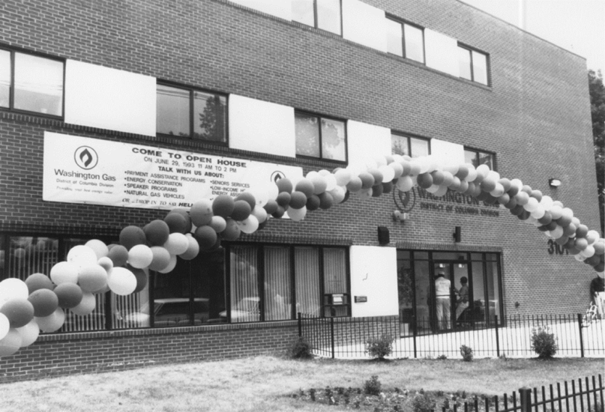
Washington Gas Light’s (WGL) Anacostia Customer Service Center
The Anacostia Customer Services Center opened in May of 1993

Slide 24
WGL Intent to Close Payment Center
WGL opened Center in May 1993.
WGL informed PSC of intent to close Anacostia Customer Service Center (December 2, 2002) because:
Not cost effective,
Customers had other bill payment options, and
Alternative Payment Locations were available.

Slide 25
PSC Investigation of Closing
The PSC issued Order No. 12627 and opened Formal Case No. 1014 (December 27, 2003);
Directed WGL to keep the Anacostia Service Center open during the investigation; and
Sent WGL a series of data requests and sought its opinion on the impact of closure on ratepayers.

Slide 26
The Office of the People's Counsel (OPC)
On January 2, 2003, OPC moved to intervene.
OPC requested a formal public hearing.
PSC issued a notice scheduling two public hearings. (January 24, 2003)

Slide 27
Public Hearings
Over thirty-five (35) members of the community spoke at the public hearings.
All opposed closing the center and eliminating the option to make cash payments at the main office location.
WGL objected but attended as observers.

Slide 28
Commission’s Findings and Conclusions
Evidence presented during the public hearings used in determination
“[failure of WGL to provide alternative payment options that allow customers to be informed of the status of their accounts is wholly inadequate”
PSC denied WGL's proposal to close the Anacostia Customer Service Center.

Slide 29
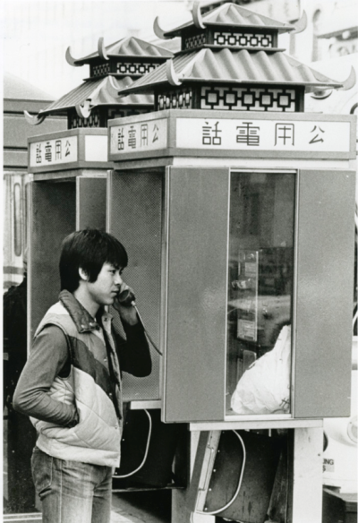
Innovative Community Based Outdoor Public Payphone Complaint Program

Slide 30
Background
In June, 1984, the FCC allowed the introduction of competition in the payphone industry.
On August 13, 1984, the PSC opened F.C. No. 829, which initiated a proceeding to establish rules for Customer-Owned Coin Operated Telephones (COCOTs).
On January 30, 1986, the PSC established COCOT rules on the basis that COCOTs were in the public interest because they increase the availability of telephone service and improve the quality of service by introducing new telephone devices.
Many COCOTs were placed in residential neighborhoods that previously had no outdoor payphones.

Slide 31
OPC Petition
On June 20,1991, OPC filed a petition for investigation re whether COCOTs are being used in a way that deprives the community of safe, adequate, and reliable telephone service.
The Consumer Utility Board (CUB) filed a supporting letter to the OPC Petition
The complaint alleged drug dealing, public drinking, loitering, littering and other forms of disorderly or undesirable conduct that encouraged and contributed to unwelcome street activity.

Slide 32
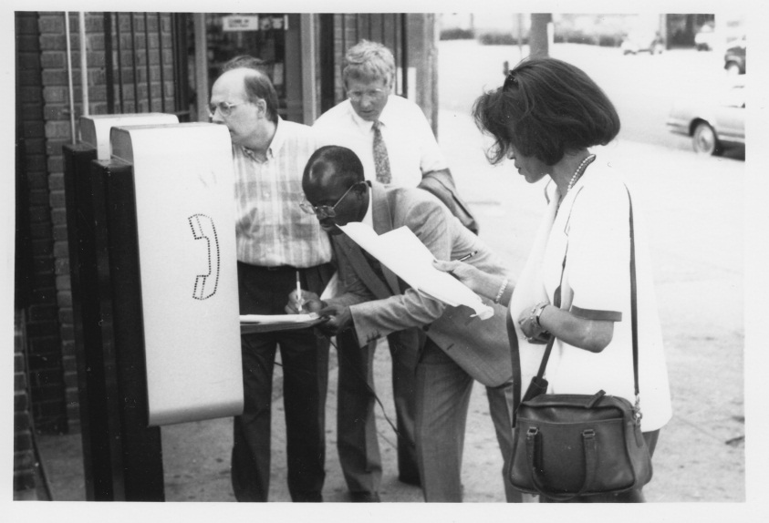
Tour of Payphone Sites
Betty Noel, People’s Counsel;
Daniel Wedderburn, President of CUB;
Howard Davenport, PSC Chairman; and
Edward M. Meyers, PSC Commissioner toured several payphone sites.

Slide 33
Balancing Public Interests
Public’s need for pay telephones
Community’s desire to be free of the underdesirable effects that these payphones
A way to resolve issues involving public pay telephones
Proceedings to change the operation of existing phones
Objections to the proposed installation of new public payphones

Slide 34
PSC Action
The PSC held 3 community hearings:
September 23
US Payphone, Co., Inc. and a Ward 7 resident testified.
September 24
Hands Together Coalition, T&T Block Club, and ANC 4B testified.
September 28
Police Department, Coalition of Concerned Citizens, Consumer Utility Board, Duggan Orange Hap Patrol, Woodbridge Movers Orange Hat Patrol, the Silver Market Neighborhood, Neighborhood Watch, Capitol Hill, Public Safety US Payphone Co., Inc., Atlantic Telco, Middle Atlantic Payphone Association, & Tel&Tel Payphone Inc. testified.

Slide 35
The PSC Established New Citizen Complaint Payphone Rules
On October 23, 1991, the PSC issued Order 9865, that amended the COCOT rules by establishing a consumer complaint process for outdoor payphones owned by C&P and COCOTs.
Payphone owners were encouraged to limit duration of calls to no longer than 10 minutes in areas where citizens were complaining of illegal drug and nuisance activity.
Payphone owners were required to notify the PSC if they transferred ownership of the payphone to another company.
The PSC encouraged payphone owners to locate the instruments in areas with sufficient lighting during daytime and nighttime hours and visible from the nearest street on which the phone is located.
Payphones must have the name and address of owner and the price of a local call displayed.

Slide 36
Establishment of Complaint Hotline
The new rules established a dedicated citizen complaint hotline that continues in operation today.
The phone number is 202-737-4PSC and it is available 24 hours a day, 7 days a week.
The phone number must be displayed on all payphones.

Slide 37
PSC Investigation of Payphone Complaints
The PSC began investigating each payphone complaint, including engaging a staff member in the Office of Consumer Services to conduct inspections of the payphones to ensure their compliance with the rules.
The rules established a process for citizens to file complaints regarding
Existing phones
Installation of new payphone; and
Implemented a new complaint form.
PSC staff inspects a payphone as part of the community based payphone program.

Slide 38
Causes of Complaints
Loitering
Suspicious activity
Continuous rude, loud or boisterous behavior by persons utilizing the phones
Official recommendation by police department

Slide 39
Possible Remedies
Conversion of service to outgoing only and notice posted on the phone so users are aware of the limitations and can file comments with the PSC within 10 business day
Limiting the capability of the phone to dial a pager
Temporary termination of service
Permanent termination of service at night with the exception of operator and 911 emergency service
Relocation of the phone
Permanent termination of phone and removal of equipment
If phone is terminated, it cannot be reconnected until at least one year after termination unless the PSC determines otherwise. Moreover, not other phone can be placed within a one business or residential block radius of that location at least one year.

Slide 40
Complaint Process for Existing Outdoor Payphones
When the PSC received a complaint regarding an existing payphone, the PSC notified the payphone owner, OPC, the local ANC, and police department.
The parties had 30 days to comment.
If there was a timely filed opposition, the PSC would conduct an informal hearing within 10 days, led by a hearing officer (attorney) in the Office of the General Counsel (OGC).
At the informal hearing, if the parties agreed, they would sign a settlement agreement.
If they didn’t agree at the informal hearing, a date and time was set for a formal hearing to be conducted by another attorney in OGC. The hearing officer had 10 days to render a decision.

Slide 41
Complaint Process for Installation of New Outdoor Payphones
When the PSC received a request to install a new payphone, it would notify OPC, the local ANC, the police department, and any other interested groups or individual where the phones were to be located.
The parties had 30 days to comment, including opposing the new installation.
If there was a timely filed opposition, the PSC would conduct an informal hearing within 10 days, led by a hearing officer (attorney) in OGC.
If the parties agreed, they would sign a settlement agreement.
If they didn’t agree at the informal hearing, a date and time would be set for a formal hearing to be conducted by a different hearing officer in OGC. The hearing officer The hearing officer was to render a decision in 10 days.
All new payphones were required to provide two-way incoming and outgoing service unless the PSC determined otherwise.

Slide 42
Formation of Working Group with Citizen Participation
The PSC formed a Working Group composed of OPC, PSC staff, C&P the Middle Atlantic Payphone Association, an ANC, the Police Department and any other interested persons or organizations that wanted to participate.
This was the first Working Group in which a citizen group was represented.
The purpose of the Working Group was to evaluate the PSC’s procedures for monitoring usage, and report on any needed additions to the rules.
Over time, the PSC approved additional citizen groups to serve on the Working Group such as CUB, ANC 2B and ANC 6A.
The Working Group filed 6 reports between 1992 and 1995 that recommended modification to the rules.

Slide 43
Working Group Recommendations Approved by the PSC
Allow payphones to accept credit cards
Eliminate requirement that payphones post telephone numbers of PSC and OPC on fluorescent decals because it was easy to remove them. Instead, require information to be posted on a card that is permanently affixed to the payphone.
Extend deadline for informal hearings from 10 to 30 days because ANCs meet only once a month.
The PSC approved all of these recommendations.

Slide 44
1993 - PSC Chairman Davenport & Commissioners Alexander & Meyers Patrolled Problem Areas at Night with “Orange Hat” Citizen Groups as They Consider Modifying the Rules

Slide 45
New Public Payphone Installations Process
Application for the installation of a new payphone
Opportunity to challenge
PSC notifies the payphone owner, local ANC, MPD, and OPC of proposed payphone
Mediation hearing is held conducted by PSC staff attorney
Informal conference seeks a settlement agreement.
Formal hearings, appeals and PSC review if no settlement agreement.

Slide 46
Payphone Informal Conference
Illicit activity or public nuisance + PSP not willing to remove the phone, within fourteen (14) days = hearing or informal conference
Scheduled at any time convenient to parties
Notice given to:
ANC; MPD; OPC; complainant if known
Seek to bring about an agreement between all parties, for the operation of the payphone.
Settlement agreement

Slide 47
Payphone Formal Hearing
If no agreement can be reached as a result of the informal conference,
Within thirty (30) days, a formal hearing is held.
Notice again sent to the payphone owner, ANC, MPD, and OPC.
Right to introduce evidence, call witnesses, and present oral arguments.
The Hearing Officer renders a decision within twenty (20) days of the closing of the record in the case.

Slide 48
Evolution of Payphone Complaint Process – 1991 to Date
Overtime, the number of complaints regarding existing public payphones was reduced, and more complaints were received regarding new installations of payphones.
In the last decade, most complaints have been regarding graffiti on the relatively small number of payphones still in existence. Today, there are only 55 outdoor public payphones in the District.
Proliferation of cell phones has contributed to the reduction in the number of public payphones; the latter may still be necessary in the event of an emergency when cell phones will not work.

Slide 49
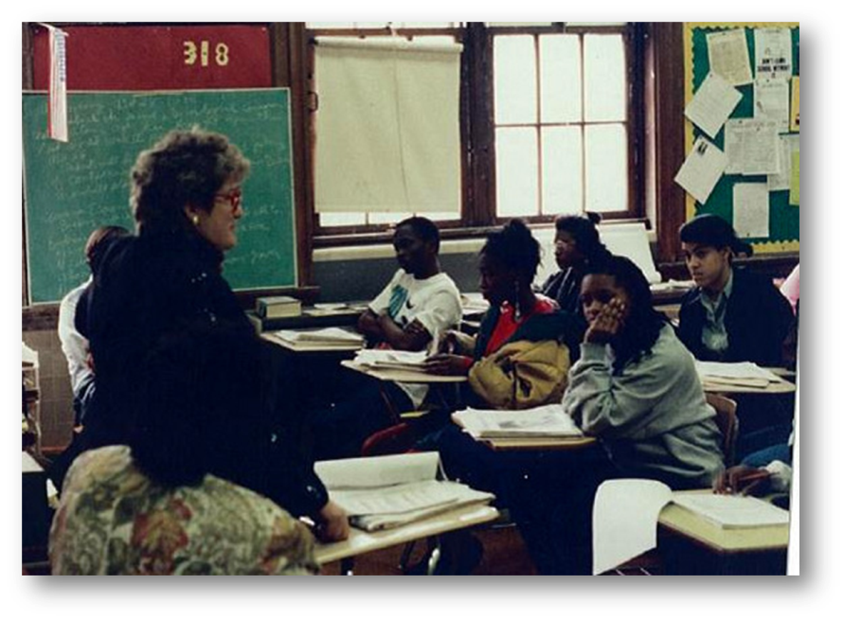
People Serving the Community Educating the Public Campaign

Slide 50
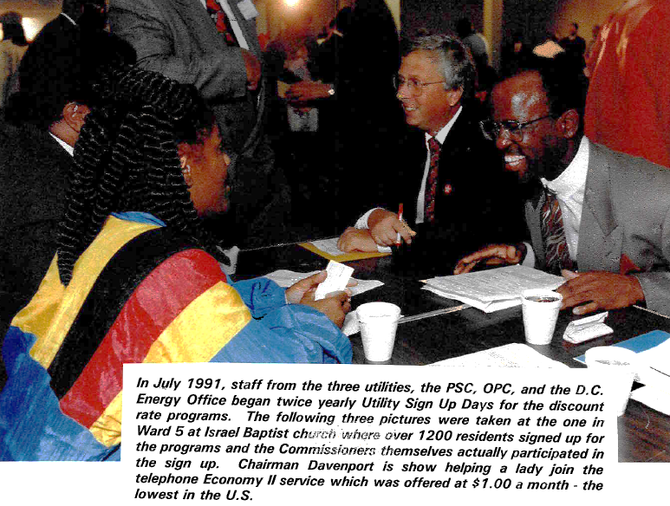
Joint Utility Discount Day - JUDD

Slide 51
JUDD - Sign-ups for Low-Income Discount Programs

Slide 52
Take It to the Streets

Slide 53
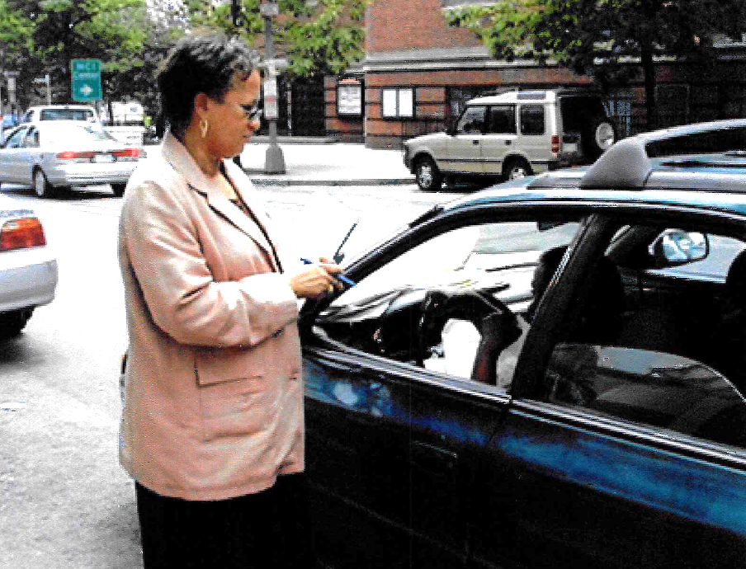
Take It to the Streets

Slide 54
Community Service

Slide 55
Educating & Serving Diverse Communities

Slide 56
Helping the Deaf & Hard of Hearing

Slide 57
Telephone Relay Service Advisory Board Meeting

Slide 58
Captel Demonstration

Slide 59
Use of Technology to Educate Consumers & Inform the Public

Slide 60
Website & eDocket System
Located on PSC website
Orders and Dockets
Search Current Dockets
Index of Formal Cases and Order Captions
Search Index of Formal Cases
Search Index of Commission Orders
Search Commission Orders
Most Recent Filings
Search Archived Dockets
CDA and Service Lists
Current Open Cases
Service Lists
Commission-Directed Actions Calendar
User Filings and Registration
Login to eDocket System
New User Registration
Subscribe to Commission Dockets
Public Meetings
Subscribe to Public Meetings
Media Streaming

Slide 61
Media Streaming

Slide 62
PSC Mobile App

Slide 63
Conclusion
Providing mechanisms for public input will not only aid in achieving democratic goals, but it can also lead to more informed policy decisions.
Increased public participation allows companies to obtain information that may help them better understand how current policies could be improved and also how the public willl respond.
Responding to public input is just as important, if not more, than providing a mechanism for such input.

